Slide 1
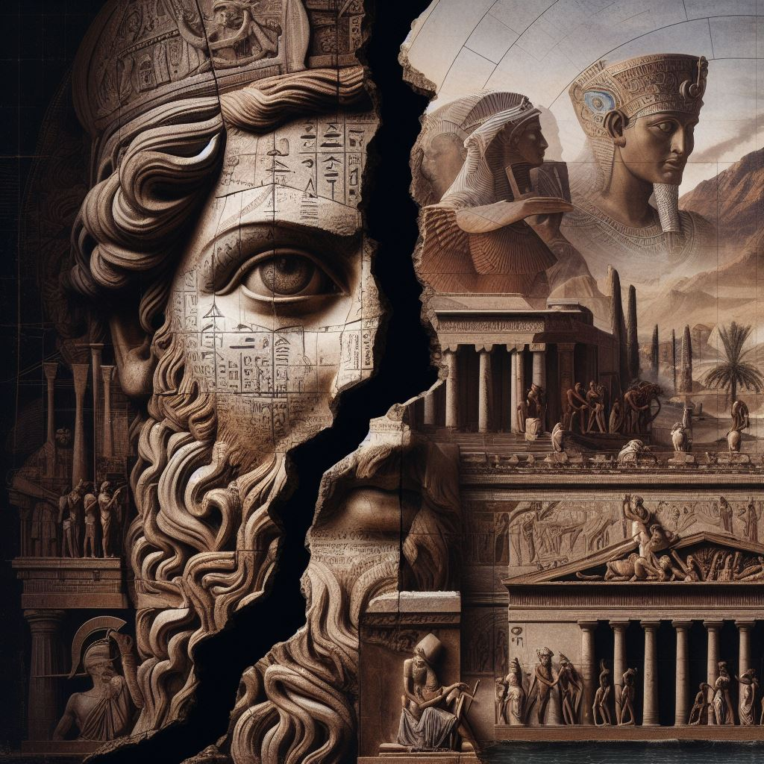
Political Structures
GOAL/S: Explain the political structure/s of Ancient Rome
Week 1, Lesson 3

Slide 2


When the last king of Rome was expelled in 509 BCE, a constitution was developed that aimed to represent the unified and independent mindset of the new Republic. As the system developed in the centuries following 509 BCE, the constitution created new institutions so that the Republic would fulfill the driving concept of Senatus Populusque Romanus or ‘SPQR’ – The Senate and People of Rome. The people would work with the Senate through various elected magistracies and assemblies to collectively govern Rome. Power would be invested in the hands of many, not few or one. After their experiences of being ruled by a monarchy, Romans feared the threat that overwhelming power vested in one person, such as a king, presented.

Slide 3
Watch the following:
https://www.youtube.com/watch?v=Kpb1ioOYRHc&ab_channel=KhAnubis

Slide 4
Discussion Question
What do you already know about the roman political structure?

Slide 5
The Magistracies
Various magistracies (or political positions) were responsible for ensuring the effective day-to-day running of the Republic.
The cursus honorum provided the structural framework for these positions.
All positions were re-elected annually with the exception of censor (18 months) and dictator (a position only created and filled in times of crisis for a maximum of six months).
Minimum ages and levels of prior military or legal experience were also set to ensure that those holding such positions had the capability to do what the job required

Slide 6
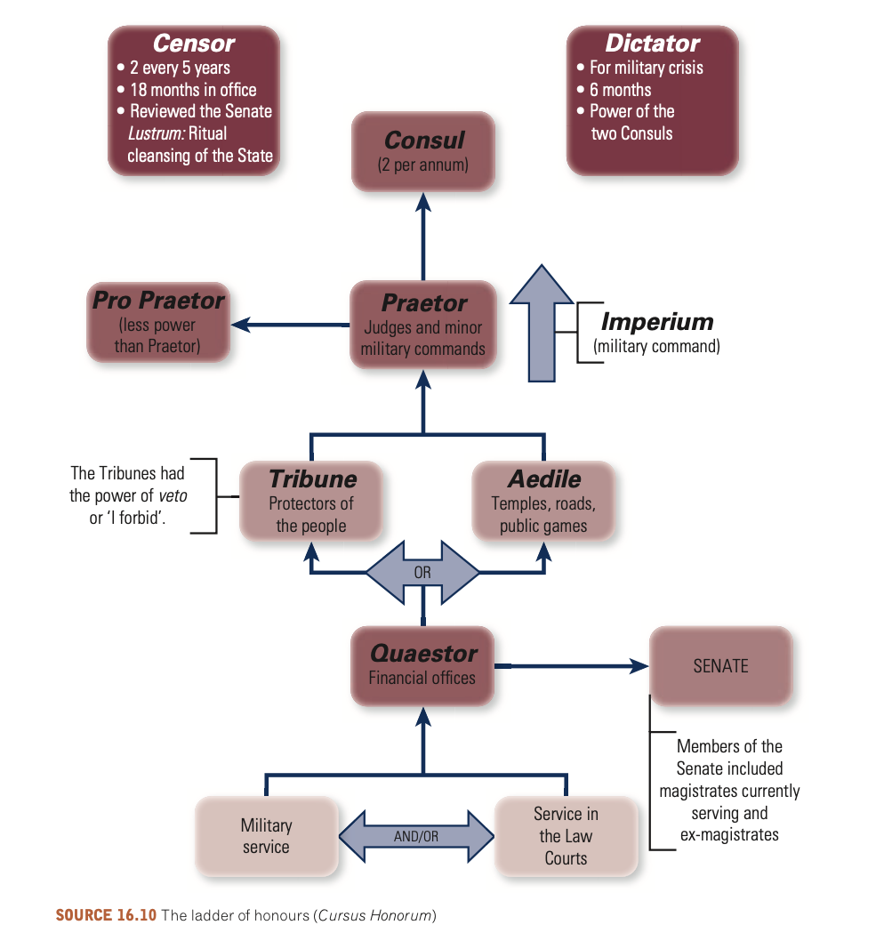

Slide 7
The Assemblies
Four main assemblies
Every male citizen eligible to vote on legislation and the election of magistrates
Assemblies met only to vote – not to discuss or initiate action
Legislation was initiated by an individual magistrate, developed in the Senate, and then taken to the respective assembly for voting.
No amendments were permissible
The task of the assembly was simply to vote yes or no.

Slide 8
The Senate
Once the Republic was established, the Senate considered itself the guardian of the new constitution.
It grew in prestige during the Second Punic War (218–201 BCE) thanks to its authority to grant military commands.
When commanders were successful, it reflected positively on the Senate.
The source of the Senate’s power lay in the ancestral custom of mos maiorum.
This unwritten code of values, whereby supreme authority lies in the hands of the elders, gave the Senate an informal ability to make decisions without the formal legal authority to do so.
As the Republic grew, the appointment of individuals to the Senate began to follow less stringent guidelines.

Slide 9
In theory, the system of assemblies established in the Republic was equitable. As Rome expanded its influence a variety of inherent problems emerged:

Slide 10
ACTIVITY - Mindmap
Create a mindmap of problems that emerged in Rome

Slide 12
TEACHER ONLY
In order to vote, an individual had to be physically present. The expanding Republic often drew people away on campaign or business. If they could not attend, their vote was not counted.
Senators and patricians often used their influence to sway the voting, essentially monopolising political decisions.
Senators controlled what legislation came before the assemblies. In that sense, the Republic was arguably more oligarchic than truly democratic.

Slide 13
The Struggle of the Orders
Read through the information sheet
Respond to the questions

